Slide 1
Micron ID1
Keng Wai Ren
05 Dec 2024
Rev 1

Slide 2
Objective
To evaluate the water chemistry for CFRO brine to ATFD
Mix TMAH and Aquatar into CFRO brine and send for ATFD
200,000 mg/l NaCl, 1000 mg/l TMAH, 50 mg/l Aquatar
Test distillate for TMAH and Aquatar

Slide 3
Test Methodology
Prepare Synthetic Feed – 1L
Perform water analysis
Determine Crystals Structure
Synthetic feed was prepared with DI water and NaCl.
TMAH and Aquatar were added into the solution.
Analyse synthetic feed with TOC/TN.
Feed was split into two jars. Distillation with and without vacuum.
Distillates were collected and analysed for COD, TOC and TN
Salt cake formed was collected.

Slide 4
Water Analysis – For MLD Application
Distillation with vacuum
Samples | COD | TOC | TN
Feed | * | 514.4 | 162.2
Distillate 2 | 1136 | 242.4 | 1
Distillate 3 | 84 | 23.16 | 0.81
Distillate 4 | 8 | 1.731 | 0.248
Distillate combined | 18 | 17.94 | 4.38
Conc | * | 1287.2 | 458.8
*Not measured due to high chloride interference

Slide 5
Water Analysis – for ZLD Application
Distillation
Samples | COD | TOC | TN
Feed | * | 514.4 | 162.2
Distillate initial | 10 | 5.191 | 0.21
Distillate final | 85 | 61 | 17
Final operating temperature approximately 140C.
*Not measured due to high chloride interference

Slide 6
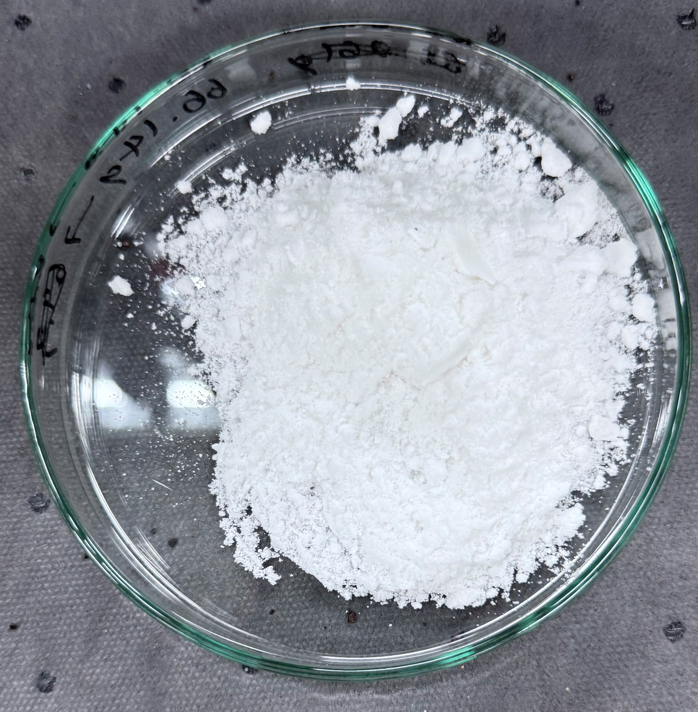
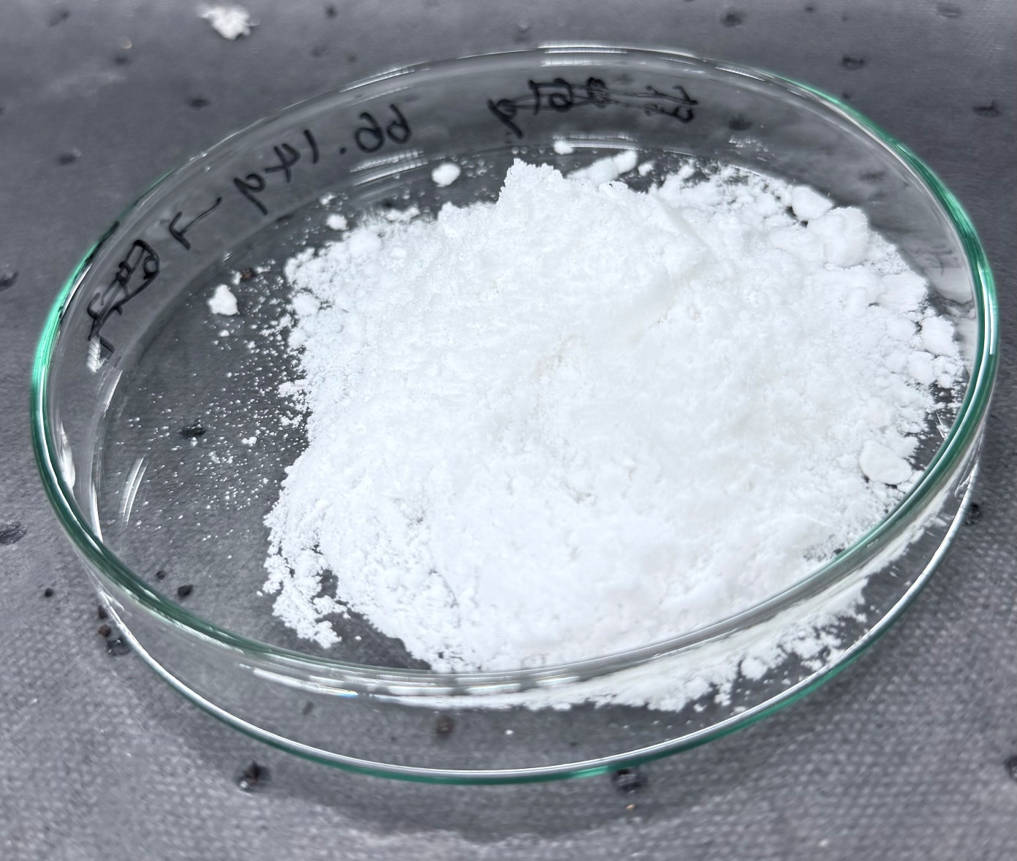
Salt Cake Collected

